Slide 1
Demand forecasting for energy consumption
DASS Project Spring 2020, IIIT Hyderabad

Slide 2
Project details
Given hourly energy consumption data of client’s commercial complex, we need to make a web-app where user can input a time range and get predicted energy consumption value and predicted electricity cost for that duration of time which can be used to manage monthly budget of the company.
Client : Mr. Malliswar Tekumudi, Indriyn Data Analytics
Mentor : Vijayraj Shanmugaraj
Team No. : 12
Members : Akshat Goyal, Kanish Anand, Nikunj Nawal, Sridhar M

Slide 3
Project description
In this project we basically developed a algorithm which predicts future energy consumption values for a complex. For this purpose we used Facebook’s prophet algorithm along with various external regressors like temperature , holiday effect.
Along with this algorithm we made a webapp which provides various functionalities like predicting the energy consumption values, getting graphical analysis of predicted consumption for given time range, option to download predicted data, dashboard showing various statistics of user’s building and showing 5-day weather forecast.

Slide 4
Why is it useful ?
This will help user to know the future energy consumption and expected cost of electricity.
User can take preventive measures regarding the anomalies
1
3
2
User can plan budget of office accordingly
4
Helps in deciding and planning for maintenance of the power systems.
Notes:
Future energy consumption
To estimate resources neded
To

Slide 5
Timeline
Domain knowledge gathering, requirement collection and analysis
Offline model for prediction and graphical analysis of data
Final deployable system after testing
Week 1 & 2
Week 3 & 4
R1
Week 5 & 6
R2
System designing and prototyping
Detailed system designing, complete frontend and system integration

Slide 6
Energy Prediction Model : We have implemented ML Model Prophet to predict the future energy consumption. Graphical Analysis of the actual data and predicted data is also done. We will be presenting the model in the jupyter notebook.
Web App (Part of R2): A Webapp is made using Express, NodeJs and MongoDb. The webapp has login, register use cases. After login, user can enter date and time and will get the predicted energy consumption on the webApp.
R1

Slide 7
User Interface : An interactive user interface is developed for the users. The webapp offers many functionalities like login, register, view temperature, energy and budget prediction, graphical analysis of energy consumption, anomaly detection in consumption, notification system, dashboard and customer care.
ML Model : ML Model trained in R1 is linked to the user interface which takes date and time and will predict the future energy consumption.
Feature Engineering : We added temperature and holiday as features in model.
R2

Slide 8
Past Year Temperature Data : We arranged to get previous year’s temperature data required for our model.
Weather Prediction : Predicted weather predictions using Open Weather API.
Download Data option : Apart from our main SRS we also provided some extra features due to client’s demand like option to download predicted data values for both graph and normal prediction.
Testing : APIs will be tested using Postman and Pytest. Unit testing is also done.
R2

Slide 9
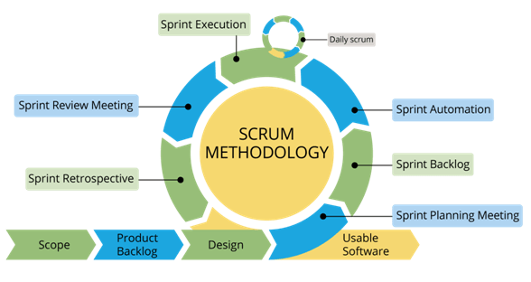
Product Development
Scrum is an agile project management methodology or framework used primarily for software development projects with the goal of delivering new software capability every 2-4 weeks.
01 | Customer collaboration over documentation
02 | Process, actions and results are very well documented
03 | Working software over comprehensive documentation
04 | Individual and team interactions over process and tools
05 | Responding to change over following a plan

Slide 10
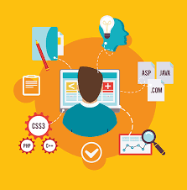
Design Principle
In this project we used MVC dgn pattern. The Model View Controller (MVC) design pattern specifies that an application consist of a data model, presentation information, and control information. The pattern requires that each of these be separated into different objects.

Slide 11
Model
The Model contains only the pure application data, it contains no logic describing how to present the data to a user. For this application we used various models :
User: This contains information of all user’s registered in the webapp which would be helpful at the time of login and for owner to list all the users.
Weather Prediction: This database stores temperature prediction values of 5-days. This is helpful at the time of prediction as for prediction we directly use temperature value from this database instead of doing weather prediction everytime we are doing prediction. This database is updated after a fixed interval of time so as to incorporate updated temperature predictions in Open Weather System. This is basically the caching of predicted temperature values to make process fast.
Predicted Values: This database stores predicted energy consumption values which user predicts for some time range. We are storing this so that if next time again user wants to predict energy for same time range or for a part of saved time range then prediction don’t take much time and we can show the output in very less time. This is basically the caching of predicted values to make prediction process fast.

Slide 12
View
The View presents the model’s data to the user. The view knows how to access the model’s data, but it does not know what this data means or what the user can do to manipulate it. Our webapps main page is a dashboard which represents various statistics for client’s office energy consumption data. Along with that we have a side navbar on every page for easy navigation. Then there a pages for energy consumption prediction, graphical analysis of prediction, weather forecast page, customer feedback page and a page for user profile option where we offer various options to user to change their profile, also here user can allow notifications using which user will receive daily notifications about energy consumption values.

Slide 13
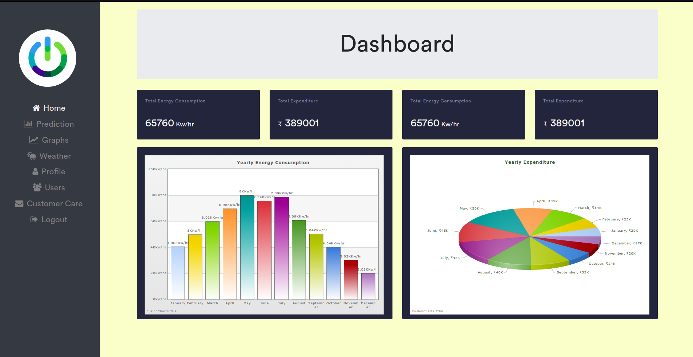

Slide 14
Controller
The Controller exists between the view and the model. It listens to events triggered by the view (or another external source) and executes the appropriate reaction to these events. In most cases, the reaction is to call a method on the model. Since the view and the model are connected through a notification mechanism, the result of this action is then automatically reflected in the view. For the controller part we implemented various functions:
Login: This function is called when user tries to submit the details on the login page after filling the username and password.
Register: This function is called when user tries to submit the details on register page after filling all specified details on that page, if some detail is of wrong format, missing or already present in database, specific warnings are given at the time of filling itself.
Dashboard: This function is called whenever user tries to see the dashboard of the webapp. This function extracts data from company’s spreadsheet using Google Spreadsheet API. Through this dashboard is updated with live company’s energy consumption data.

Slide 15
Predict: This function is called whenever user submits the prediction form where user has to input the date time range for predicting energy consumption value. This function predicts energy consumption using our saved ML model and shows the corresponding value.
Graph: This function returns graph of predicted energy consumption and is called whenever users submits on graphical analysis page.
Weather: This function returns the predicted weather which is predicted using Open Weather API. This function is called whenever user goes to weather page. Further in backend after a fixed interval of time predicted weather is stored in database for fast output at the time of prediction.
Profile Modify: This function helps at the time of updating the user profile when user wish to do so by going to specific page.
Customer Care: Using this function mail is sent to maintainer’s of the webapp from the company. This function is called whenever users submit the feedback form for some complaint.
Get Users: This function returns list of all users registered in the webapp. This function is only called when the owner click specific button on the webpage. Only some specific users will have the permission to view all users.
Logout: This function is for logging out from webapp when user click specific button.

Slide 16

Basic Features
Sign Up / Sign In for different types of user like Financial Team, Technical Team etc.
Prediction of future energy consumption and budget for given time range.
Graphical Analysis of Energy Consumption for different time ranges.
Download the predicted data in any format.
Anomaly Detection and Notification System.
Customer Care/Help.
Notes:
Sign acc to usr

Slide 17


Machine Learning
Prophet is a procedure for forecasting time series data based on an additive model where non-linear trends are fit with yearly, weekly, and daily seasonality, plus holiday effects.
System works best with time series that have strong seasonal effects and several seasons of historical data. Prophet is robust to missing data and shifts in the trend, and typically handles outliers well.
In this energy consumption prediction problem we are using Prophet model to fit model with seasonality , daily , weekly and holiday effect on electricity consumption values. Using this pattern we are predicting energy consumption value.

Slide 18
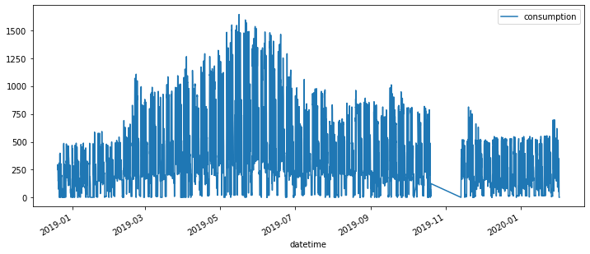
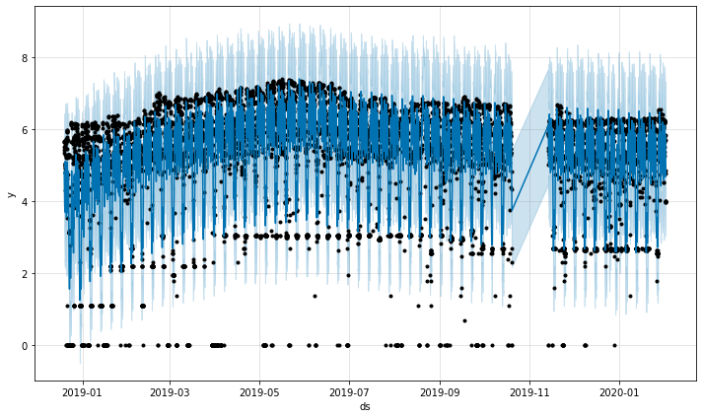
Monthly distribution of given data
Actual vs Predicted data

Slide 19
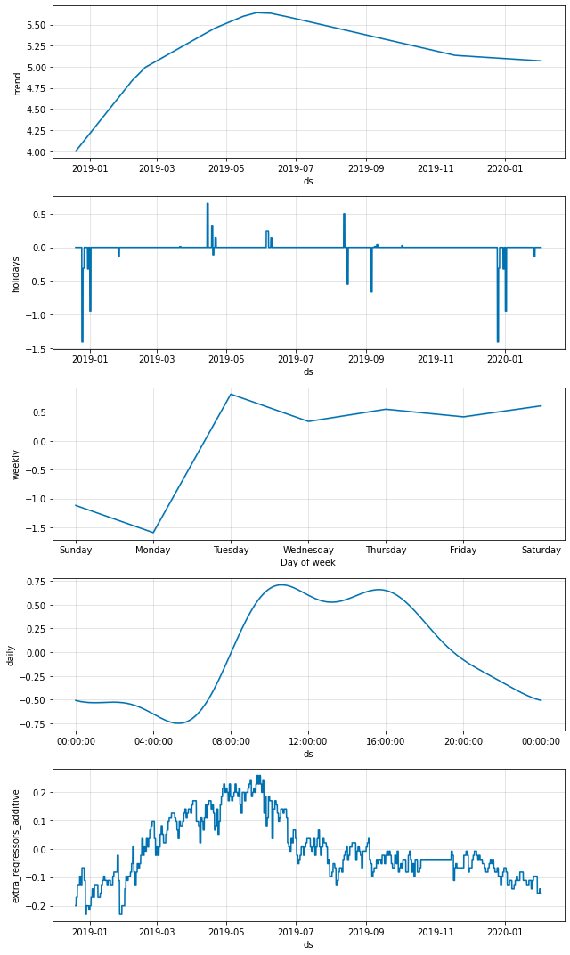
Monthly, weekly, hourly, holiday and temperature effect on predicted energy consumption values

Slide 20
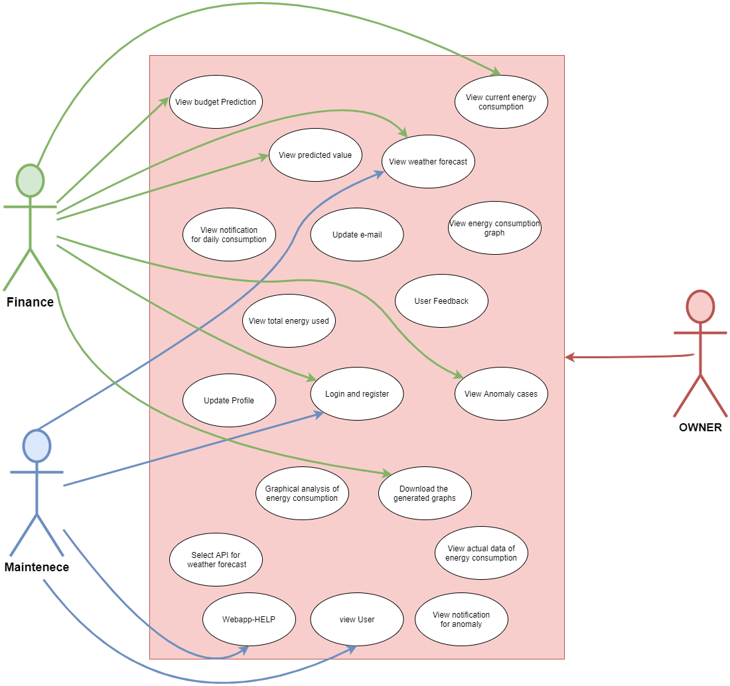
Use Case
Diagram

Slide 21
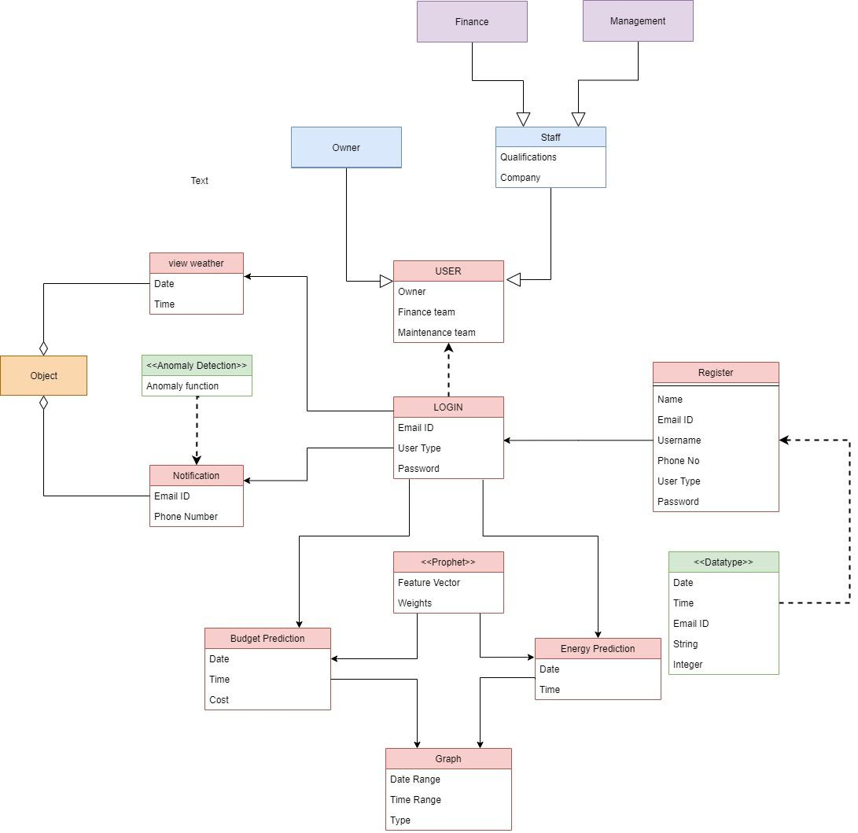
UML
Class Diagram

Slide 22
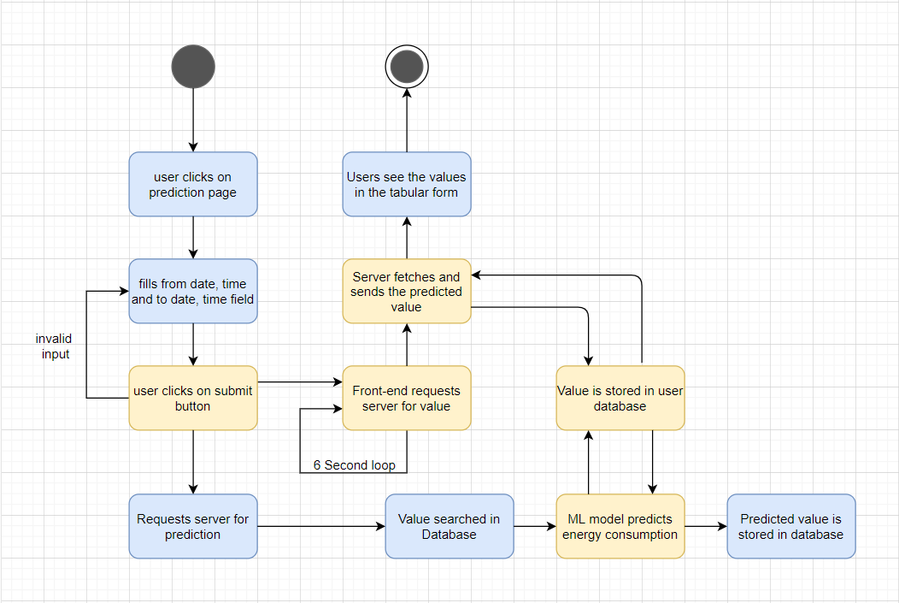
UML
State Diagram

Slide 23
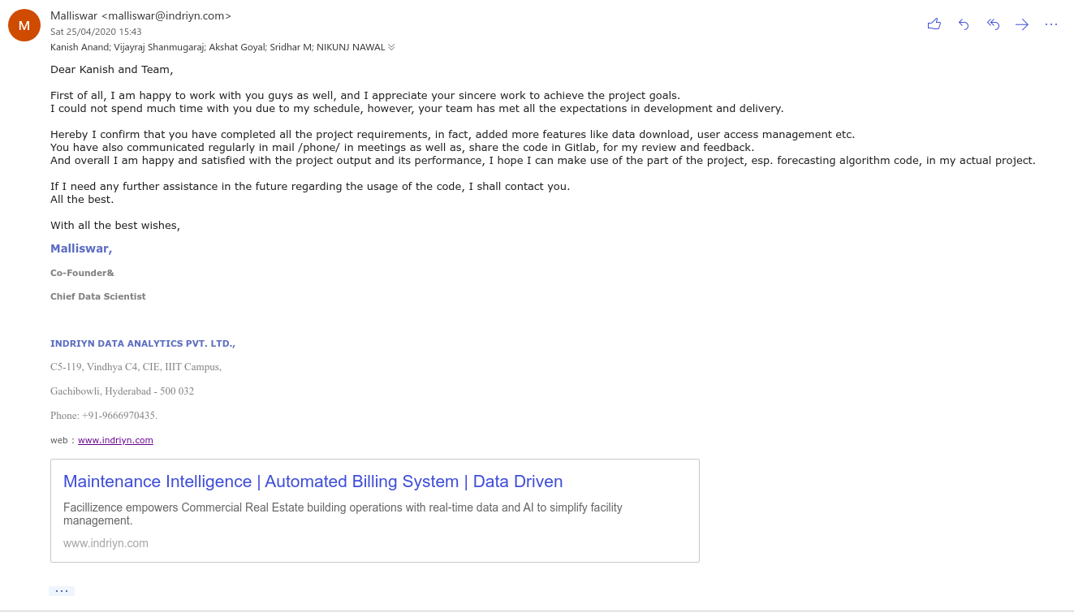
Client Feedback

Slide 24
Product DEMO

Slide 25
Testing
White Box Testing for unit testing: For unit testing we wrote various tests which tested various components of webapp if they are doing proper validation or not and giving correct output or not.
Pytest, postman for api testing : For testing API’s we used pytest library of python. In this we called all API’s used in our system and checked whether call is working properly or not through assertion statements at various points. Also here we did testing of external API’s too like: Google Spreadsheet API, Open Weather API.
Sandwich testing for integration testing: For this testing we tested if integration between frontend and backend is proper or not by testing all the endpoints.

Slide 26
Thank you.

